Slide 1

Conflicts of Interest and Other Ethical Pitfalls
April 2017
Craig D. Henley
Senior Bar Counsel

Slide 2

Who is Complaining?
52% of the time it is the client
20% of the time it is the opposing client
4% of the time it is the opposing counsel

Slide 3
What are they complaining about?
15% Communications
15% Diligence
10% Lack of compliance with client directions
9% Fees
8% Conduct prejudicial to admin. of justice
6% Dishonesty
3% Conflict of Interest

Slide 4
What areas generate charges?
35% Criminal Law
11% Family Law
8% General Civil Practice
6% Personal Injury
5% Probate/Estate Planning
5% Trust Account

Slide 5
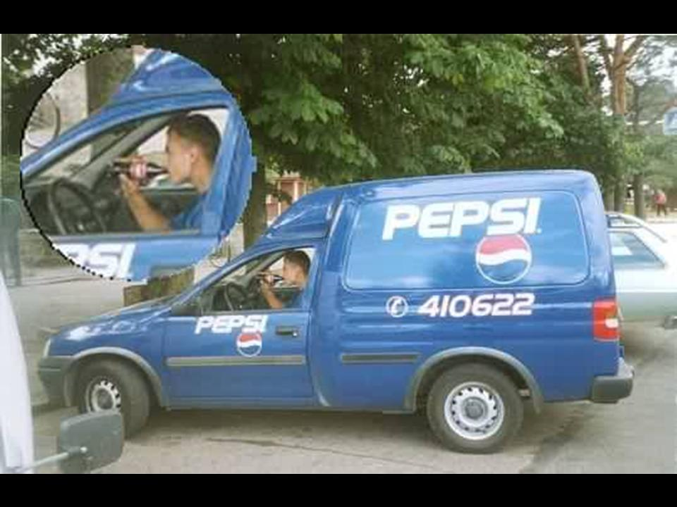
Conflicts of Interest
ER 1.7
ER 1.8
ER 1.9
ER 1.10
ER 1.11
ER 1.18

Slide 6
Conflicts of Interest
Rule 42, Ariz. R. Sup. Ct., ER 1.8:
(a) No business transactions with a client or acquired interest adverse to client unless: (1)transaction and terms are fair and reasonable/fully disclosed/transmitted in writing, (2)the client is advised in writing of the desirability of seeking and is given reasonable opportunity to seek independent counsel on the transaction, and (3) the client gives informed consent, in a writing signed by the client;
(c) No solicitation of any “substantial gift”, including a testamentary gift;
(e) No financial assistance except: (1) costs of litigation, the repayment of which and (2) indigent clients
(f) No payment by non-client unless: (1) informed consent, (2) no interference with independence, and (3) information is protected by ER 1.6
(h) No agreements limiting liability for malpractice or discipline;
(j) No sex with clients.

Slide 7
Conflicts of Interest
Having an effective conflicts checking system is vital
  Parties should always be included
  Should include Individuals and Companies
  Also wise to include Witnesses
  May want to include non-party spouses
Conflicts come in three main flavors:
  Potential clients [Online submissions] – ER 1.18
  Current clients – ER 1.7
  Former clients – ER 1.9

Slide 8
Conflicts of Interest
ER 1.18
  Governs prospective clients
  If they’ve given you information, you can’t reveal such information
  You also can’t represent adversely to them in a related matter or where the information would be harmful to them
  This conflict generally is waivable
  This conflict can sometimes be cured by screening [ER 1.18(d)]

Slide 9
Conflicts of Interest
ER 1.7
  Governs current clients
  Can’t represent if directly adverse to each other
    Driver & passenger often creates issues
  Can’t represent if significant risk your duties to someone else or own personal interest would risk materially limiting the representation
  Waiver of conflict?
    Only if you’ll still be able to properly represent each client and there’s not a claim by one client against the other in the same case

Slide 10
Conflicts of Interest
ER 1.9
  Governs former clients
  Can’t represent another client against former client in the same or substantially related matter
  Can’t use or reveal any information relating to the former representation [See also ER 1.6]
    So if you have info, you have a conflict.
  Waiver of conflict?
    Yes. Informed consent in writing generally permits

Slide 11
“Informed Consent” & “Confirmed in Writing”
When a conflict is waivable, Rules often refer to above-referenced terms.
“Informed Consent”: Denotes the agreement by a person to a proposed course of conduct after a lawyer has communicated adequate information and explanation about the material risks of and reasonably available alternatives to the proposed course of conduct.
“Confirmed in Writing”: When used in reference to the informed consent of a person, denotes informed consent that is given in writing by the person or a writing that a lawyer promptly transmits to the person confirming an oral informed consent. If it is not feasible to obtain or transmit the writing at the time the person gives informed consent, then the lawyer must obtain or transmit it within a reasonable time thereafter.

Slide 12
In re Stanley, PDJ 2016-9059
In both counts of the Complaint, Mr. Stanley represented the named defendant in a lawsuit and later filed a Substitution of Counsel in order to allow him to represent a named corporate plaintiff in place of opposing counsel. Mr. Stanley then filed a Notice of Dismissal on behalf of the corporate plaintiff dismissing all claims against the named defendant. One week later, Mr. Stanley filed a separate lawsuit “derivatively on behalf of and for the benefit of” the corporate plaintiff. As a result of his actions, the Superior Court judge sanctioned Mr. Stanley $19,298.50 plus interest until paid.

Slide 13
Sanction
Reprimand and Two Years of Probation for violating Rule 42, Ariz. R. Sup. Ct., ERs 1.7(a)(2), 3.1, 3.2, 4.4(a) and 8.4(d). Terms of Probation included participation in the Law Office Management Assistance Program (LOMAP) and the Member Assistance Program (MAP) along with costs and expenses totaling One Thousand Two Hundred Seven Dollars and 56/100 ($1207.56).

Slide 14
Where To Get Help?
Where can you go for help?
  Ethics Hotline – 602-340-7284
  MCLE – 602-340-77327
  Unauthorized Practice of Law – 602-340-7292
  Fee Arbitration – 602-340-7379
  Law Office Management Assistance – 602-340-7332
  Membership Records – 602-340-7239
  Report Attorney Misconduct – 602-340-7280

