Slide 1
Modern Day Fraud Risks
Phoenix, AZ
January 23rd, 2018
© 2016 Wells Fargo Bank, N.A. All rights reserved. For public use.

Slide 2

Biography
Ryan McCaffrey
Wells Fargo Bank
Regional Treasury Consultant Manager
Based in Phoenix

Slide 3


Agenda
Fraud Trends
Online Account Takeover Fraud
Impostor Fraud
Internal Controls
Ways to Mitigate Fraud Risk
Call To Action

Slide 4

Remain vigilant in payment fraud
73%
71%
48%
  of organizations experienced attempted or actual payments fraud
  of the organizations reported the actual or attempted fraud stemmed from paper checks.
  of organizations were exposed to wire
  fraud — a significant increase from the previous survey
Source: 2016 AFP Payments Fraud and Control Survey
Notes:
According to the 2016 AFP survey ….
73% of organizations experienced attempted or actual payments fraud, which is gradually climbing YOY
71% of the organizations reported the actual or attempted fraud stemmed from paper checks
48% of organizations were exposed to wire fraud – a significant increase from the previous survey.
With those statistics in mind, it’s important to become educated around fraud threats – Payments Fraud, Account Takeover Fraud and Impostor Fraud. We’re going to dive deeply into each of these threats today as well as some best practices you should incorporate to protect your company.
Let’s get started…..

Slide 5
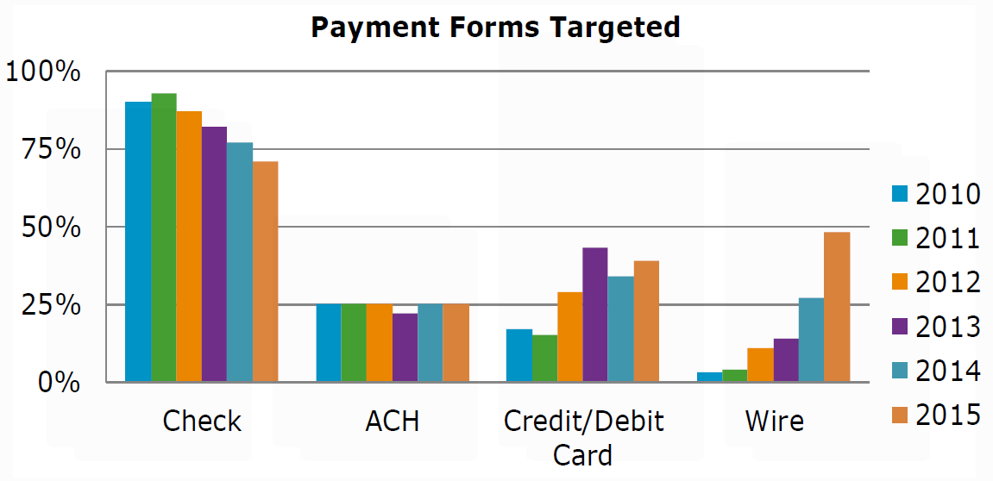
Payment fraud trends
Source: 2016 AFP Payments Fraud and Control Survey
Notes:
Shifting payment strategy. Move away from check usage with use of ACH and Credit Card.

Slide 6
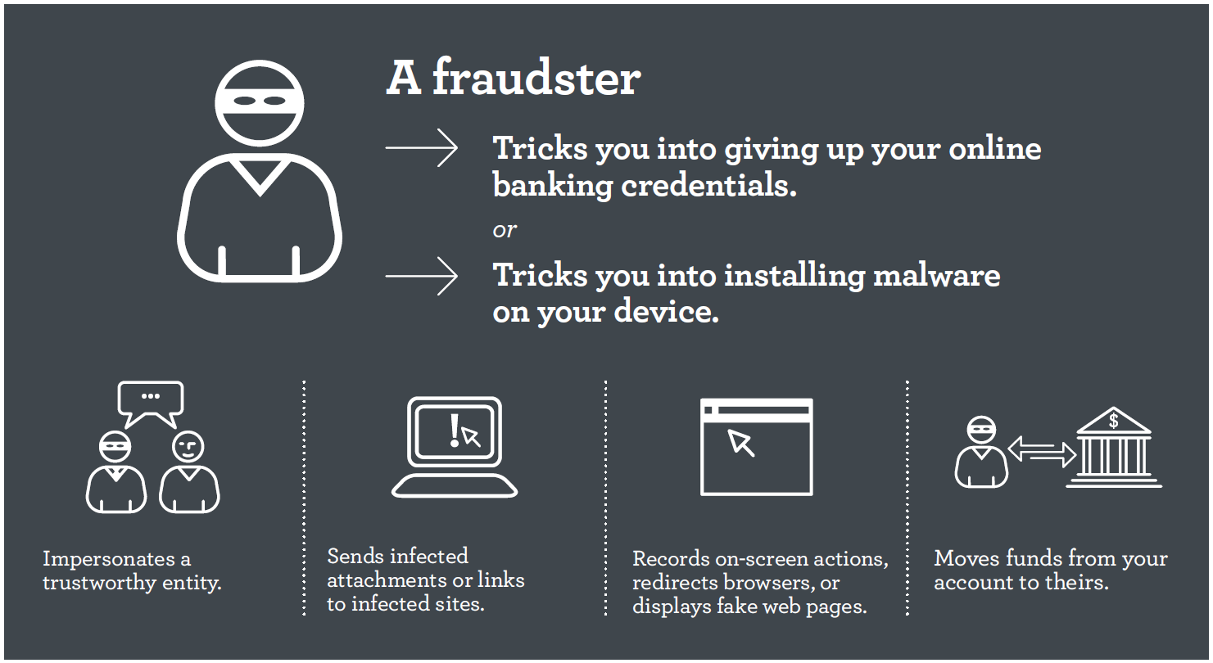
Online account takeover fraud
What is account takeover fraud?
Notes:
Account takeover fraud involves a fraudster stealing your confidential information to access your online accounts directly.
They accomplish this by via Social Engineering, which is manipulating you into performing actions or divulging confidential information by impersonating a trustworthy entity; or they can obtain your confidential information via Malware that was unknowingly downloaded to your device, which can capture all on-screen actions and supports session take-over activities.
It’s important to note that anyone who uses a PC for email or web surfing is at risk for downloading malware. Carriers of malware include infected documents attached to emails, links in emails that connect to an infected site, infected search engine results and documents, and videos, photos and banner ads posted on legitimate sites, particularly social networking sites. Social media has become a gold mine for fraudsters – I’ll talk more about that in a minute.
And the goal again for fraudsters is to leverage your credentials to move funds from your account to theirs.
You might be sitting here saying to yourself – I know all about phishing attempts. I’d never fall for them – they’re so obvious. But are they?
There are several different strategies fraudsters use to obtain our confidential information
The classic phishing attempt is still heavily used. This is where mass emails are sent out by fraudsters purporting to be from an organization where there is an established relationship. Think back to the number of data breaches that have been in the news. Customer data is purchased by fraudsters that aids in their phishing attempts.
Another strategy is Vishing – which is where the fraudster picks up the phone and makes contact with the their victim. We are seeing tactic used more and more, and with the ability to spoof Caller ID, it’s easy to become a victim if you’re not careful.
Similar to Vishing, there is also Smishing, which is when the fraudsters send a fraudulent text, typically with a link. If you click on the link, malware is installed on your device.
Last is Spear-phishing, which is a tactic that is becoming one of the fraudster’s favorites. Spear-phishing is where there is a targeted attack directed at a small group of potential victims. Because they’re more customized, they have a higher degree of believability and therefore, a higher open rate. According to Symantec’s Internet Security and Threat report, in 2014, 60 percent of all spear-phishing phishing attacks struck small- and medium-sized organizations, so users need to be extremely careful.

Slide 7
1 in 220
Email malware rate
Source: Symantec, Internet Security Threat Report, Volume 21, April 2016
Notes:
One out of every 220 emails contains malware or a link to malware.
If that doesn’t make you gasp, what about the fact that there was 317 million NEW malware variants detected in 2014. Key word is detected.
Let’s explore how cybercriminals have become more adept at accomplishing their goal of stealing financial or other data.

Slide 8
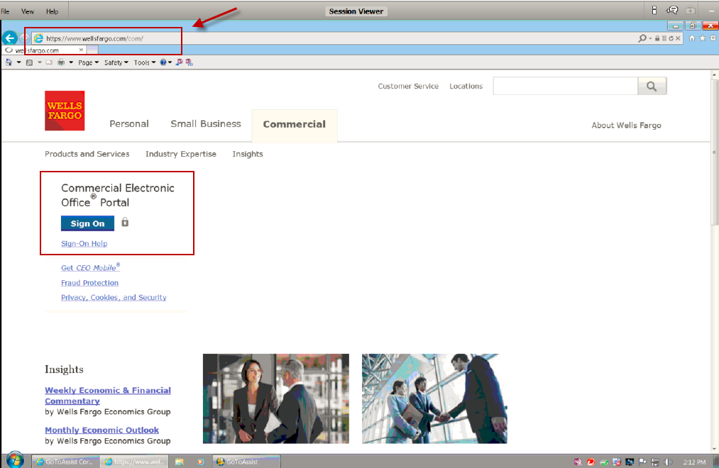
Example of malware
Notes:
Customer receives phishing email and inadvertently downloads malware. (NO PICTURE/ANIMATION)
CLICK
Malware enables fraudster to divert customer to ‘fake’ CEO Portal pages and obtain credentials, including token codes. (IMAGE APPEARS ON CLICK)
*Unexpected Token prompt appears at login
CLICK TO REMOVE IMAGE AND MOVE ON
Page displays a delay message while fraudster is busy logging on to CEO Portal and initiating payments. (IMAGE APPEARS ON CLICK)
*while customer was waiting for security parameters to be “checked’, the fraudster used their credentials to login to the real CEO Portal and initiate a wire.
CLICK TO REMOVE IMAGE AND MOVE ON
Malware also allows the fraudster to insert pop-up messaging requesting customer contact information. CLICK FOR IMAGE
CLICK TO REMOVE IMAGE AND MOVE ON TO NEXT BULLETS
Fraudster calls customer claiming to be from Wells Fargo to discuss customer’s unreported “system issues”.
Fraudster is looking to engage other users to log into CEO Portal using the same device in order to compromise their credentials as well.

Slide 9
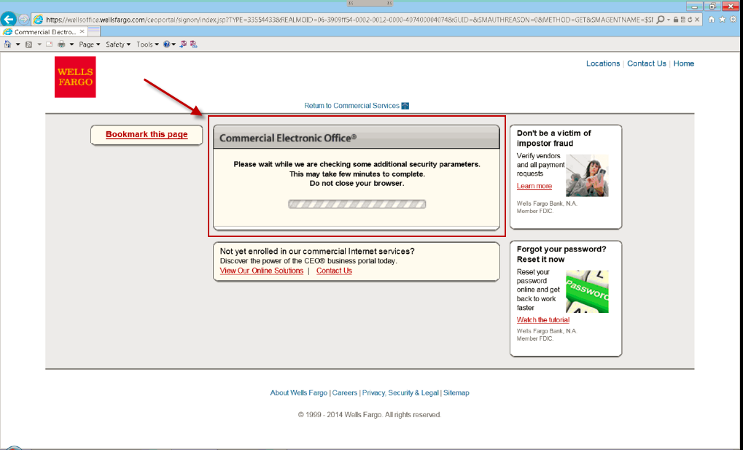
Example of malware
Notes:
Customer receives phishing email and inadvertently downloads malware. (NO PICTURE/ANIMATION)
CLICK
Malware enables fraudster to divert customer to ‘fake’ CEO Portal pages and obtain credentials, including token codes. (IMAGE APPEARS ON CLICK)
*Unexpected Token prompt appears at login
CLICK TO REMOVE IMAGE AND MOVE ON
Page displays a delay message while fraudster is busy logging on to CEO Portal and initiating payments. (IMAGE APPEARS ON CLICK)
*while customer was waiting for security parameters to be “checked’, the fraudster used their credentials to login to the real CEO Portal and initiate a wire.
CLICK TO REMOVE IMAGE AND MOVE ON
Malware also allows the fraudster to insert pop-up messaging requesting customer contact information. CLICK FOR IMAGE
CLICK TO REMOVE IMAGE AND MOVE ON TO NEXT BULLETS
Fraudster calls customer claiming to be from Wells Fargo to discuss customer’s unreported “system issues”.
Fraudster is looking to engage other users to log into CEO Portal using the same device in order to compromise their credentials as well.

Slide 10

Impostor fraud
The fraudster
Poses as a person or entity you know and trust
Contacts you by email, phone, fax, or mail
Requests a payment, submits an invoice, or asks to change vendor payment instructions
If you fall for the scam, any payments you send go to the fraudster — not where you intended.
Notes:
What is Impostor Fraud?
Fraudster poses as a person of authority within your company or a vendor or business partner and requests a payment or a change to existing payment instructions. If you act on the request, you send money directly to the fraudster
Other names
Supply Chain Fraud
Man in the Email
Masquerading
Business Email Compromise
Let’s take a look at how the fraudsters are making contact with their victims

Slide 11

Email hacking
The fraudster
Takes over full access to the email account
Studies email patterns, checks calendars
Sends emails from the user’s account
undetected
  Will intercept a reply
  to a hacked email and continue to perpetrate
  the scheme
Notes:
Email Hacking
Is when the fraudster takes over full access to the email account
There are no red flags….he can send emails and intercept incoming emails at will
And also do reconnaissance
Check calendar….when out
Trading partners
Writing style
Etc.
BOTTOM LINE…..EMAIL SHOULD NOT BE TRUSTED FOR PAYMENT RELATED ACTIVITY

Slide 12
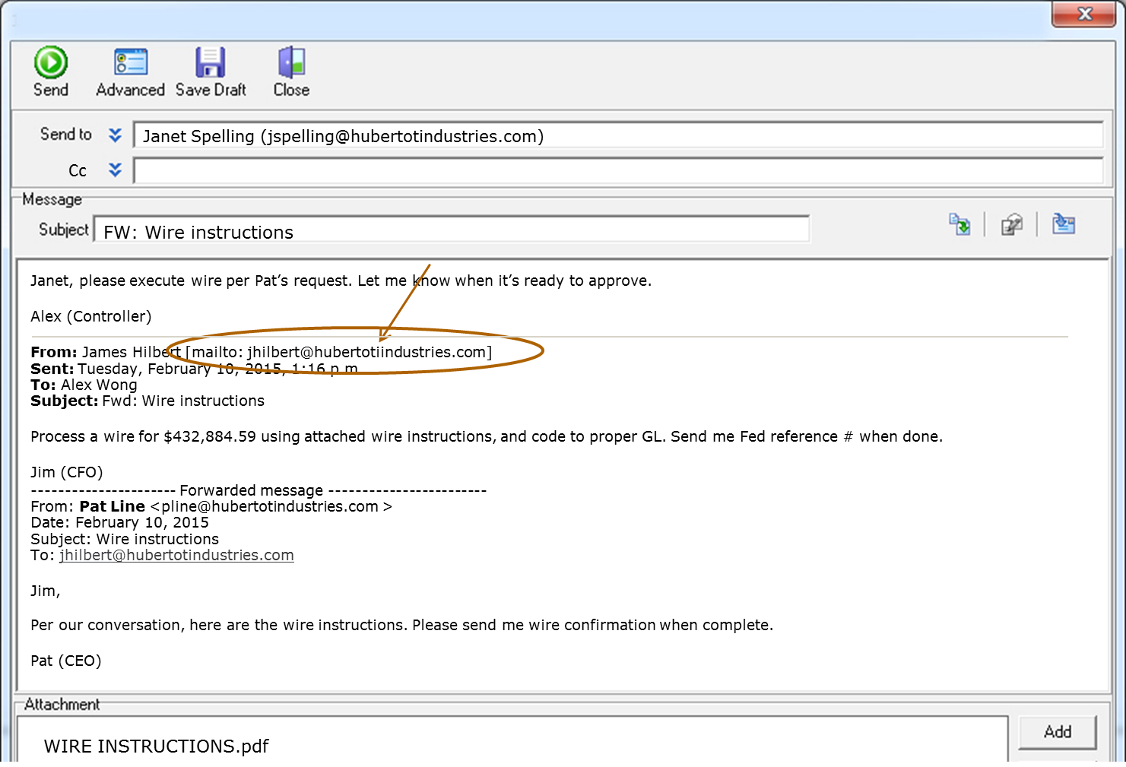
Example of executive email spoofing
Notes:
Email spoofing….
Is when someone purchases an email domain that is very similar to your company’s email domain but slightly different
Most of us don’t look at the email domain on the emails we receive and if we do, still wouldn’t notice the subtle difference
This is an example of a spoofed email…note the extra i….
This is incredibly easy and low-tech to do….leader names and their associated email addresses are readily available on corporate websites

Slide 13
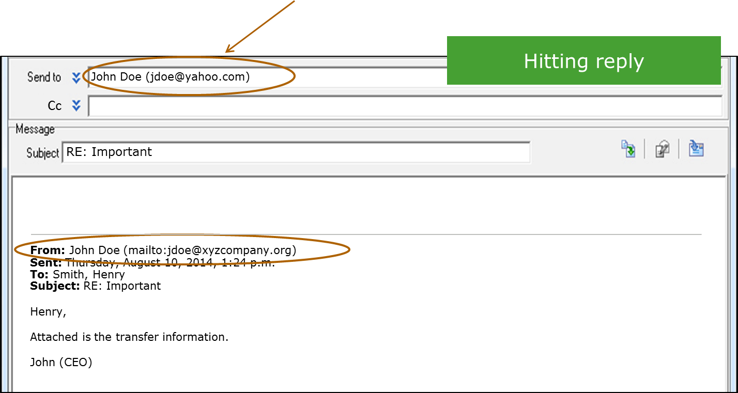
Checking for a spoofed email by hitting reply
Warning: Do not actually reply. You’d be replying to the fraudster.
Notes:
Be warned: this will not always reveal a spoofed email address. If it is an email account takeover, the spoofing characteristics will not apply.

Slide 14

Executives make perfect targets to impersonate
Always on
the move
At the top of the approval hierarchy
May occasionally request
ad hoc payments
Can be very demanding
Business needs trump accounting rules
Notes:
Executives make perfect targets of people to impersonate.
Make your executive team aware of this immense risk to their organization.
Because of this threat, organizations will have to make changes to their culture (that is, make it OK to question/verify payment requests). This will be challenging.

Slide 15

Vendors also impersonated
Companies often have
many vendor relationships
Correspondence with vendors
is typically conducted via email
Vendors often supply new account numbers
Notes:
As the industry moves from a paper to an electronic world, email has become the main communication process. This fraud is manipulating/using communication as the primary point of entry, so email just became a lot less trustworthy. In fact, Impostor Fraud uses two main ingredients to perpetrate the crime: email as main communication source, lack of procedure to authenticate requests with trusted source.
Fraudsters may ask you to send wires to non-U.S./EU nations, including: Hong Kong, Taiwan, China, Indonesia --- not an exhaustive list but can indicate a red flag
Fraudsters have to open accounts to receive funds and often choose countries with potentially lax account-opening KYC policies.

Slide 16

Impostor fraud red flags
Red flags
Request to remit payment to new/different bank account you’ve never sent money to before
Request to remit payment to new/different country you’ve never sent money to before
Request for secrecy around payment (confidential/top secret)
Switch from commercial beneficiary to individual beneficiary: XYZ Manufacturing vs. Jane Smith
Slightly blurred logo on vendor letterhead or invoice indicating item may have been altered
Warning: If the email has been hacked, all email addresses will appear legitimate.
Notes:
How to stop impostor fraud. Discuss impostor fraudster tricks and some red flags/warning signs/things to look out for.

Slide 17
Customer scenario
Notes:
Tanya’s client story regarding the CEOs email was hacked and sent an email to the CFO and RM to send a $68k wire. The CFO sent it.

Slide 18

Internal embezzlement
40% of thefts were committed by an employee in the finance/accounting function.
49 The median age of the perpetrator
$294,354 median loss
*The 2016 Hiscox Embezzlement Study
Notes:
Other Embezzlement Statistics:
Four of every five victim organizations had fewer than 100 employees; just under half had fewer than 25 employees
One out of every three employee thefts involve organizations in financial services or non-profit industries
36% of cases involved projected losses in excess of $500,000
20% of losses involved $1million or more
Women commit more embezzlement than men at 56.3%, men are close behind and increasing YOY

Slide 19
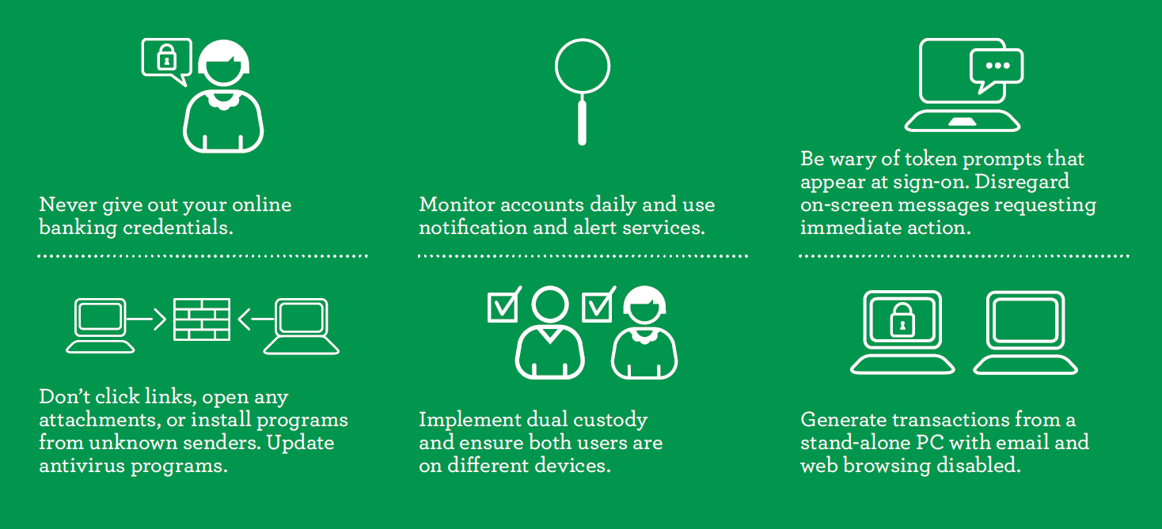


Best practices
Ways you can protect your business
Notes:
Protecting against online fraud is a partnership between Wells Fargo and our customers
There is no silver bullet so we take a layered approach that involves preventative measures and that also leverages proactive detection capabilities
Like us…it’s important for you to take a layered approach. Fraudsters are penetrating all levels of the organization. Make sure everyone is educated and aware of the imposing threats, and implement several of the following best practices…
Protection
• Layered approach. We have several layers of bank monitoring and multiple systems
to secure information. Additionally, we require secondary authentication with a
PIN + RSA SecurID® token code combination for all high-risk transactions such as
online payments, foreign exchange, and self administration services.
• Safeguarding your credential information. To protect the privacy of your
confidential account login information, Wells Fargo never contacts you to ask for
your passwords over the phone or through email or text messages.
• Session management. To help secure your information while interacting with your
accounts online, the Commercial Electronic Office® (CEO®) portal opens services in
separate browser windows, eliminating the interruption and confusion of pop-up
windows, and terminates your session after a period of inactivity.
• Product security. To help safeguard your data, Wells Fargo builds advanced
security features into all products and services. For example, our systems will not
release payments if they include previously confirmed fraudulent beneficiary
information.
• Fraud protection services. Wells Fargo offers several fraud protection services
to help protect you against online fraud including: ACH Fraud Filter for electronic
debits and credits, the Perfect Receivables® service for ACH and wire transfers,
Image Positive Pay for checks, and Dual Custody for services with high-risk
transactions.
DETECTION
• Advanced technology. Wells Fargo employs multiple methods of detecting suspicious
online activity and fraud. Many are undetectable by both users and fraudsters.
• Unusual activity monitoring. Wells Fargo’s fraud teams look for “out of pattern”
behavior and other suspicious activities occurring at the time of login or at transaction
submission, including transactions that exceed established payment limits.
• Transaction risk evaluation. Wells Fargo systematically evaluates the risk
associated with transactions and investigates transactions that exceed an established
risk threshold.
• Industry partnership. By working closely with anti-phishing and anti-trojan
vendors, Wells Fargo benefits from active sharing of the industry’s forensic fraud data.
We use this data to enhance and expand our fraud protection strategies for you and
your company.
• Law enforcement coordination. Wells Fargo collaborates with law enforcement
agencies to share intelligence and investigate all fraud incidents that could affect
our customers.
Implement a layered
----
Never give out your online banking credentials. Remember, Wells Fargo has your information on file. We’ll don’t need to ask for your credentials. You should never share or give this information to anyone. Protect your online banking credentials, including your token.
Also, monitoring accounts on a daily basis and using notification services will bring early awareness to a situation. The sooner you spot a fraudulent transaction, the sooner you can start your recovery efforts and take steps to help ensure you don't become a victim again. Check accounts daily to detect suspicious activity and reconcile bank accounts daily to identify unauthorized payments.
It’s also important to understand the typical behavior of the CEO Portal. For example, we do not prompt for a token code at the time of sign-on. Should you receive one, STOP and call us. Also, disregard any pop-up messages requesting for you to take immediate action.
Protect your network by not clicking on links or open attachments or install programs from unknown senders. And, maintain good network hygiene by ensuring that all firewalls, servers and applications have the latest patches.
Dual custody is one of the most effective fraud deterrents in a layered security approach. However, for dual custody to work as intended, the initiator and approver must be on different devices. The initiator and approver also must pay close attention to the transaction details — not just give them a rubber stamp.
Also, generate transactions from stand-alone PCs on which email and web browsing are disabled.
Let’s hear from one of our customers who was saved from a financial loss by utilizing one of these best practices.

Slide 20
Dual control
How it works
Best practices
Second chance to spot payment fraud
“User 1” initiates payment, “User 2” reviews and approves.
Never initiate and approve payment off of the same device.
Verify the request before you initiate and/or approve.
Don’t just give them a rubber stamp!
Notes:
Online fraud is a serious threat to your business and bank accounts. Armed with a valid online banking password and ID, thieves — internal and external — can divert funds from your accounts to theirs.
Half of organizations are using a stronger form of authentication or adding layers of security to access bank services, according to the 2015 AFP Payments Fraud and Control Survey.
Dual custody, when used properly, is one of the most important tools available to help protect your corporate accounts from the risk of fraud. This industry best practice requires two users to make online payment transactions or administrative changes, such as authorizing new users or changing user passwords.
How dual custody works
Dual custody gives you a second chance to spot a payment as fraudulent before it goes out the door.
The first user initiates a payment or administrative change. The second user, on a different computer or mobile device, must approve the payment or change before it takes effect.
By separating user tasks and performing them on different devices, you’re better positioned to identify and stop fraud before it happens. Thieves may be able to coax access credentials from the user who initiates online payments, but it’s unlikely they’ll also get credentials from the person who has to approve and release the payments.
Similarly, a rogue employee can’t make unauthorized payments to himself without another person’s approval.
We offer this capability through the CEO Portal. Check with your Self Administrator to input proper settings.

Slide 21


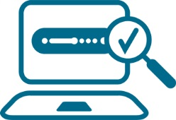
ACH Fraud Filter
Protect
  Stop all ACH transactions presented against your account
  Preauthorize designated transactions
Review
  Make pay or return decisions
  Update fraud filter criteria online
Monitor
  View unauthorized transactions
  Receive notice when an unauthorized ACH transaction is detected by fax, email, or text message
Notes:
Real-time settlement with Same Day ACH will shrink the window of opportunity for fraud recovery.

Slide 22
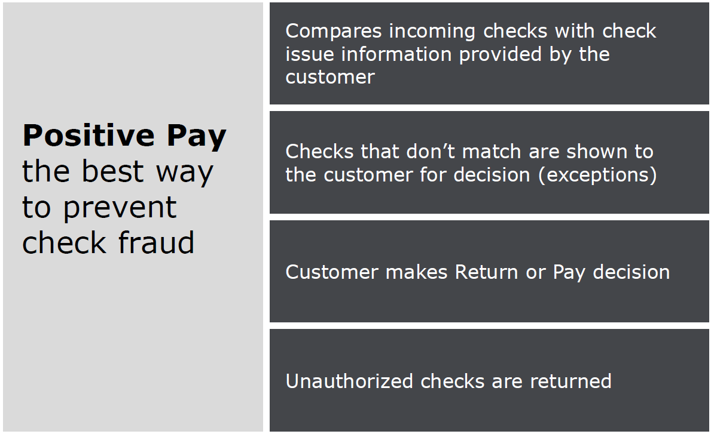
Positive Pay

Slide 23


Slide 24





Monitoring for check fraud may take as little as 1 minute each day
Fraud can happen in the blink of an eye.
With each check run
Export your check issue file from your accounting system with each check run, including date, check number, $ amount, and payee name (optional).
Export
1 min*
5 min*
Format your check issue file to the Wells Fargo Positive Pay service specifications.
Format
1 min*
Send your formatted file to Wells Fargo via the CEO® Fraud Manager service or direct transmission.
Send
Daily
1 min*
Review the CEO® Fraud Manager service for exceptions every morning and make a decision to pay or return exceptions identified.
Review
* Estimate is approximate
Wells Fargo compares checks presented for payment to information in your check issue files and loads any exceptions into the Fraud Manager service on the Commercial Electronic Office® (CEO®) portal each day for your review.

Slide 25
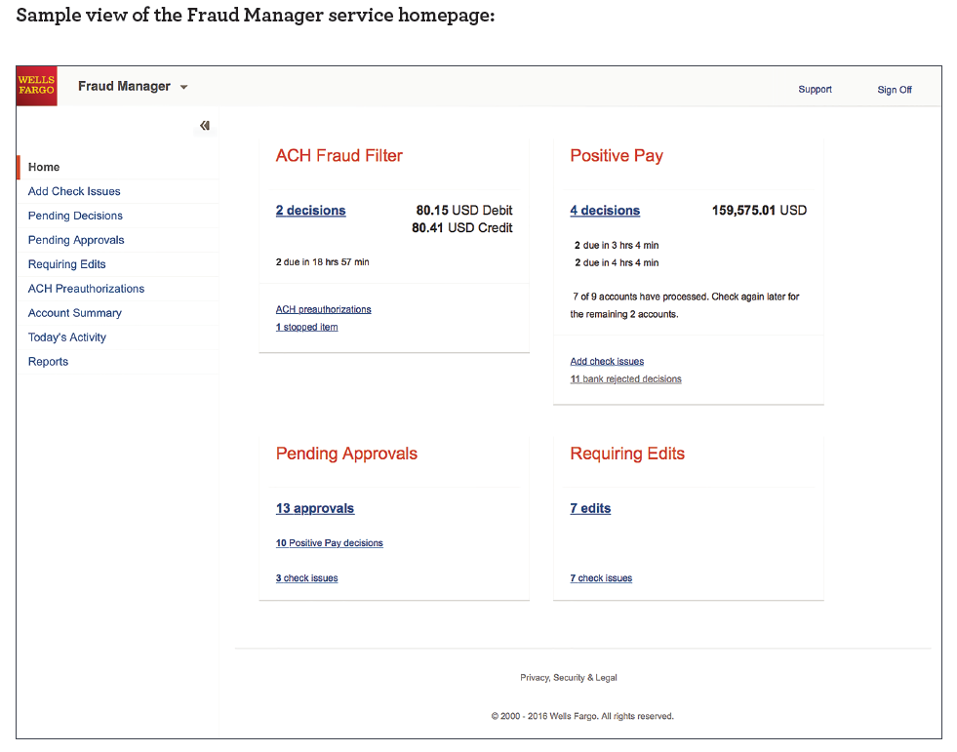
Fraud Manager

Slide 26

How fraudsters get away with it
Notes:
Fraudsters get away with it because it works. Companies still don’t fully utilize fraud tools and operate with best practices.

Slide 27
Call to action
Help increase awareness of fraud trends.
As soon as possible, meet with your:
AP staff and internal partners. Any group could be an entry
point for a fraudster.
Executives. Make them aware of the threat and ask them to
support necessary changes to mitigate risk.
Peers. Contact them to help spread the word.
Banking partners. Contact them to discuss solutions.
Take action now! You can’t afford to wait or do nothing.
Share this presentation. Fraud education is beneficial for everyone.
Notes:
Call to action
This is how we understand this type of fraud today but we know fraud techniques are always evolving. Meet regularly to anticipate how fraudsters might change tactics to overcome new defenses – example, if fraudsters are successful inserting themselves into the supply chain, might they start changing where goods are shipped and start stealing inventory?

Slide 28

If you suspect fraud
Immediately contact Client Services and tell them
you suspect fraud.
1-800-AT-WELLS
1-800-289-3557
Notes:
If you spot an unauthorized transaction or unusual activity, immediately contact your dedicated client services officer or call 1-800-AT-WELLS.

Slide 29

If we suspect fraud
Calls to validate transaction activity must be taken seriously.
Validate the authenticity of the payment request — follow best practices.
Notes:
If you spot an unauthorized transaction or unusual activity, immediately contact your dedicated client services officer or call 1-800-AT-WELLS.

Slide 30
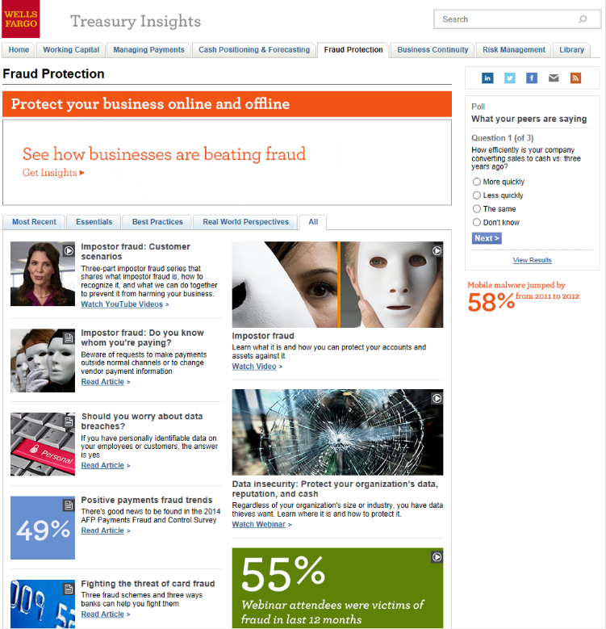
For more information on protecting your business online and offline:
Visit the Fraud Protection
page on Treasury Insights treasuryinsights.wellsfargotreasury.com
For your questions and
comments, please email us at TreasurySolutions@wellsfargo.com
Visit the Insurance Insights page:
https://wfis.wellsfargo.com/Pages/default.aspx

Slide 31
Thank you

